Slide 1
Air Quality Prediction
By,
Mohammed Ali Sheriff Shaik
A04278033
Professor: Dr. Scott King,
Data Analytics

Slide 2
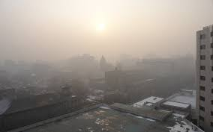
Introduction
Air quality has decreased hazardously due to the exponential increase in pollutant emissions.
The air quality Index gives us a value that helps us analyze how dangerous it is to the environment.
We use regression models to predict the following 24hr data based on the current 24hr data and various pollutants as features.

Slide 3
Data Set
Data is collected from: https://archive.ics.uci.edu/ml/datasets/Beijing+Multi-Site+Air-Quality+Data
Air quality data of two major cities of Beijing: Huairou and Aotizhongxin.
Hourly Data collected from: March,

Slide 4
Data Set Attributes
year: year of data in this row month: month of data in this row day: day of data in this row hour: hour of data in this row PM2.5: PM2.5 concentration (ug/m^3) PM10: PM10 concentration (ug/m^3) SO2: SO2 concentration (ug/m^3) NO2: NO2 concentration (ug/m^3) CO: CO concentration (ug/m^3) O3: O3 concentration (ug/m^3) TEMP: temperature (degree Celsius) PRES: pressure (hPa) DEWP: dew point temperature (degree Celsius) RAIN: precipitation (mm) wd: wind direction WSPM: wind speed (m/s) station: name of the air-quality monitoring site

Slide 5
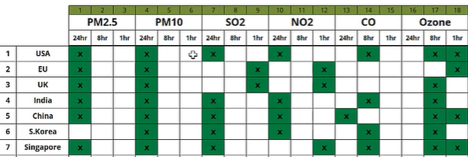
Air Quality Index Calculation
According to China
Average data by the day for all the pollutants that are the mean of 24hr, data. For PM2.5, PM10, SO2, NO2, CO.
For ‘O3’, we take the mean of every 8hr, and the average of those values will give the index for the day.
The maximum of these values is considered the Air Quality Index.

Slide 6
Primary goals
To predict the next day’s Air Quality Index.
Features: Used with lower correlation with each other.
Methods: Linear Regression, Random Forest, XGboost

Slide 7
Data Preparation
Used Aotizhongxin city’s data as training dataset and Huairou city’s data for validation and testing dataset.
Resampling train and test data for 24hrs.
Imputing missing data using KNNImputer.

Slide 8
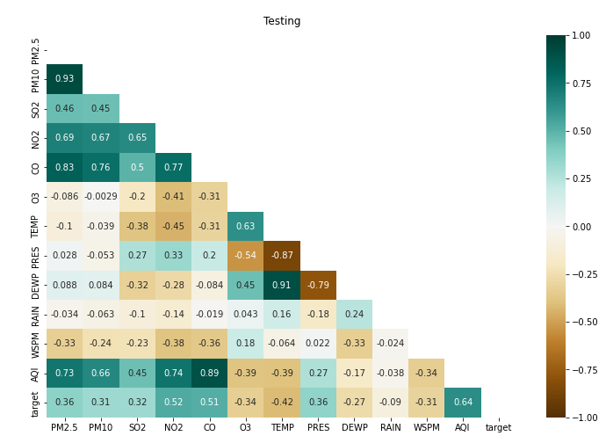
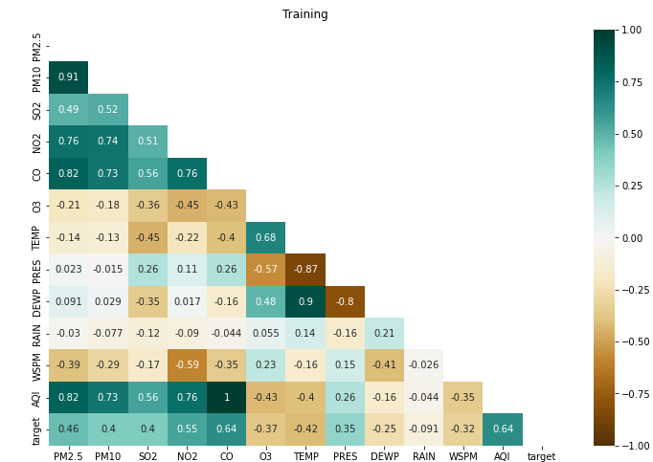
Correlation
Aotizhongxin
Huairou

Slide 9
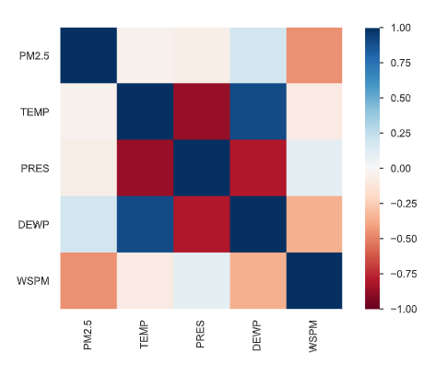
Feature Correlation

Slide 10
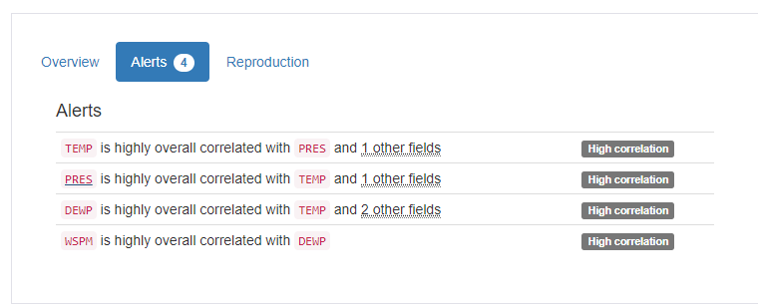
Correlation between features for feature selection
Features
The final Features would be: PM2.5, Pres, WSPM, and DEWP.
Temp is removed because it is highly correlated with all of the featurees

Slide 11
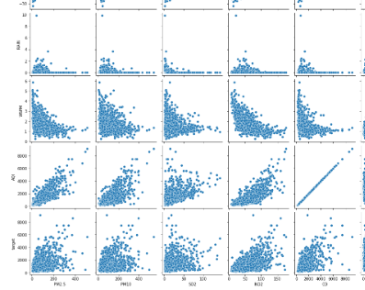
Check for Linearity

Slide 12
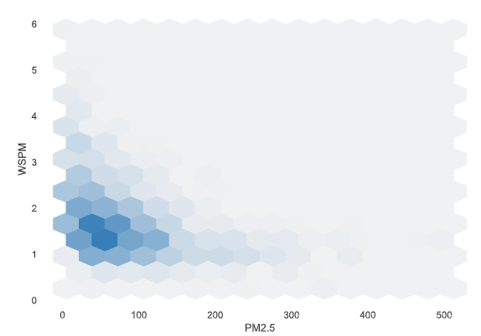
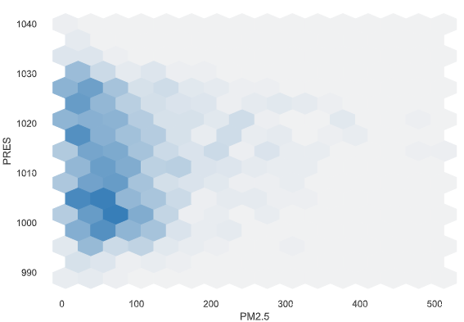
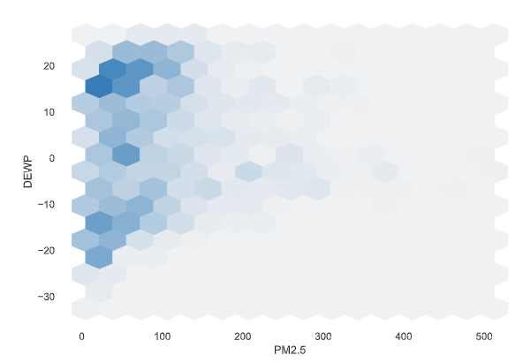
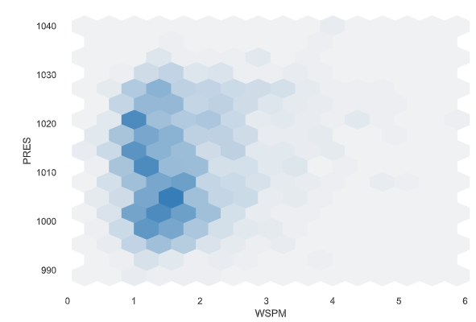
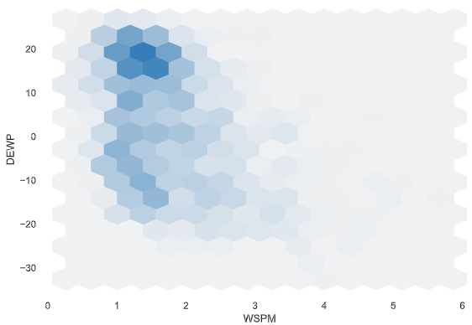
Interactions between features

Slide 13
Linear Regression
Assumes data is Normally Distributed
Check for Linearity.
Predicted values are Normally Distributed.
Errors for 1000 epochs:
Mean Absolute error: 492.27
Mean Squared error: 5878.26

Slide 14
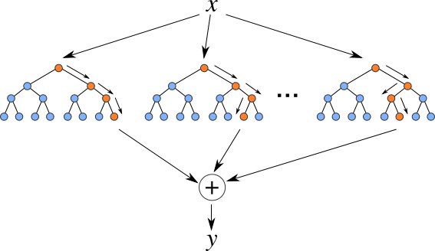
XGBoost
Additive tree model: add new trees that complement the already-built ones
Gradient boosting algorithms.
Response is the optimal linear combination of all decision trees
Popular in Kaggle competitions for efficiency and accuracy
Notes:
Xgb is another tree model，actually it is a very popular tool in data mining due to its extremely fast speed and high performance.
As a tree model, xgb can do parallel computation, 10 times faster than Random forest.
It is an additive tree model based on greedy method. In each step, a new tree is added to compliment the already built Trees. This normally gives you better accuracy with more trees. The final response is the weighted sum of all predictions from each individual trees or we can say it is the optimal linear combination of all decision trees.
For each decision tree, features flowing into the tree will finally reach the leaf by the binary critraten , we do not need to do careful features normalization. -----suitable for cate data
These two advantage makes it an ideal model in our case:
fast spead , handle large scale dataset--------
Handle cate ----anonymous features with cate and num var combined.

Slide 15
XGBoost
HyperParameters:
base_score=0.5, booster='gbtree',
n_estimators=20000,
objective = 'reg:linear',
early_stopping_rounds=100,
max_depth=3,
learning_rate=0.0001
Errors:
Mean Absolute error: 452.50
Mean Squared error: 5710.12
Notes:
Xgb is another tree model，actually it is a very popular tool in data mining due to its extremely fast speed and high performance.
As a tree model, xgb can do parallel computation, 10 times faster than Random forest.
It is an additive tree model based on greedy method. In each step, a new tree is added to compliment the already built Trees. This normally gives you better accuracy with more trees. The final response is the weighted sum of all predictions from each individual trees or we can say it is the optimal linear combination of all decision trees.
For each decision tree, features flowing into the tree will finally reach the leaf by the binary critraten , we do not need to do careful features normalization. -----suitable for cate data
These two advantage makes it an ideal model in our case:
fast spead , handle large scale dataset--------
Handle cate ----anonymous features with cate and num var combined.

Slide 16
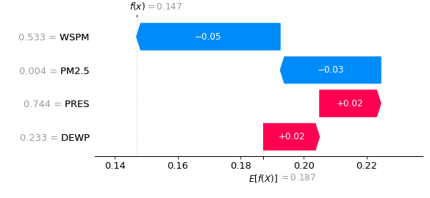
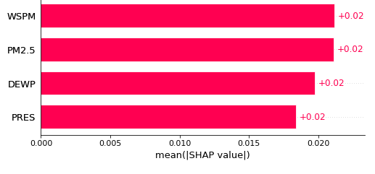
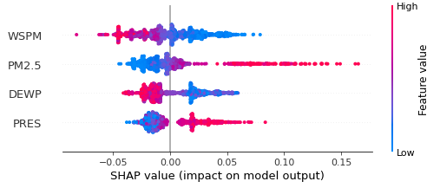
Evaluating XGboost using SHAP( SHapley Additive exPlanations ):
SHAP is a mathematical method for explaining machine learning model predictions. It is based on game theory concepts and can be used to explain any machine learning model's predictions by calculating the contribution of each feature to the prediction.

Slide 17
Summary
Data Preparation and Cleaning.
Calculated Air Quality Index using the Pollutants.
Used Xgboost and Linear Regression for predicting the next day’s data.
Calculated the Mean absolute error and Mean Squared error.
XGBoost model performed better than Linear Regression.

Slide 18
Thank you
Mohammed Ali Sheriff Shaik
A04278033

